Slide 1
COMP 350 Classic Project
Bryce Schmitt
Sean Bradley
Corey Smith
Tony Resendiz

Slide 2
Goals
Provide a platform for disbursement of funds for the Low-cost Students Loan Foundation
Track loans through database
Query, view, sort current students with loans
Provide secure login
Notify applicants upon acceptance/denial of request
Export partial or complete database records to a CSV file

Slide 3
Requirements
Developed with Java using NetBeans
Database tested with Derby but finished version utilizes MySQL
Used Github as central repository during development
Tested locally

Slide 4
Difficulties Encountered
Properly formatting JFrame and JPanel Objects for the user interface
Change in UI design led to fragments of the previous version being missed
Leftover fragments caused an error that prevented elements from the new version from appearing
Databases - synchronizing each team member’s implementation with the current version
Local usernames and password differed
The Connection Object in Java differed in each version depending on who worked on it last
Deprecation problems with database passwords

Slide 5
Results
Loan administrator (user) must be verified before program can be accessed
User enters loan applicant’s information
Application is then approved or denied
Applicant is notified via email
User can also check status of all existing loans
Single students or subsets of students may be queried and displayed

Slide 6
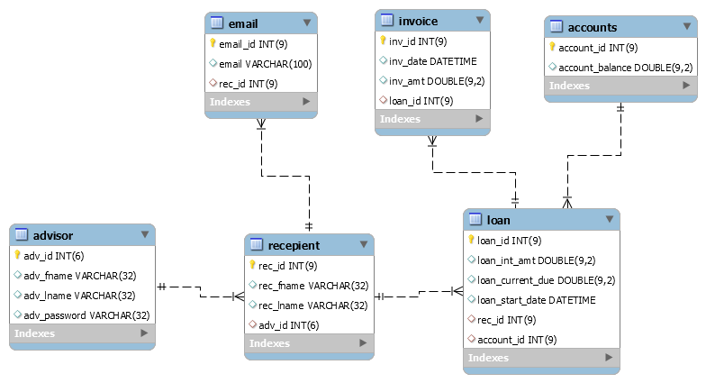
Our Database Structure

